Slide 1


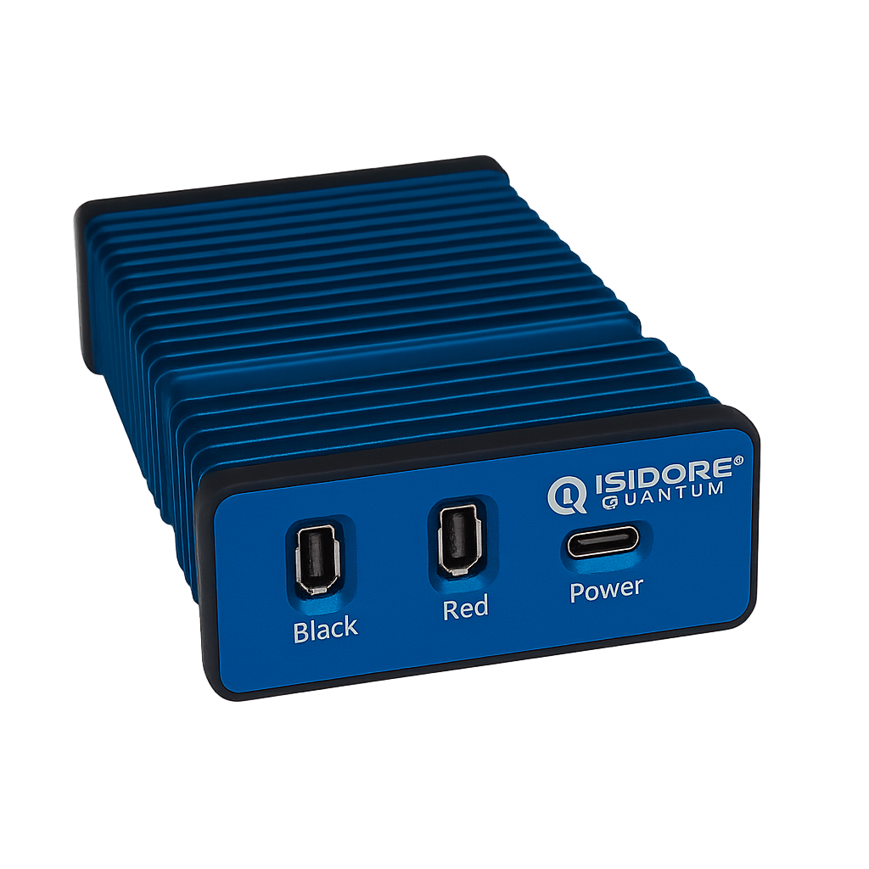

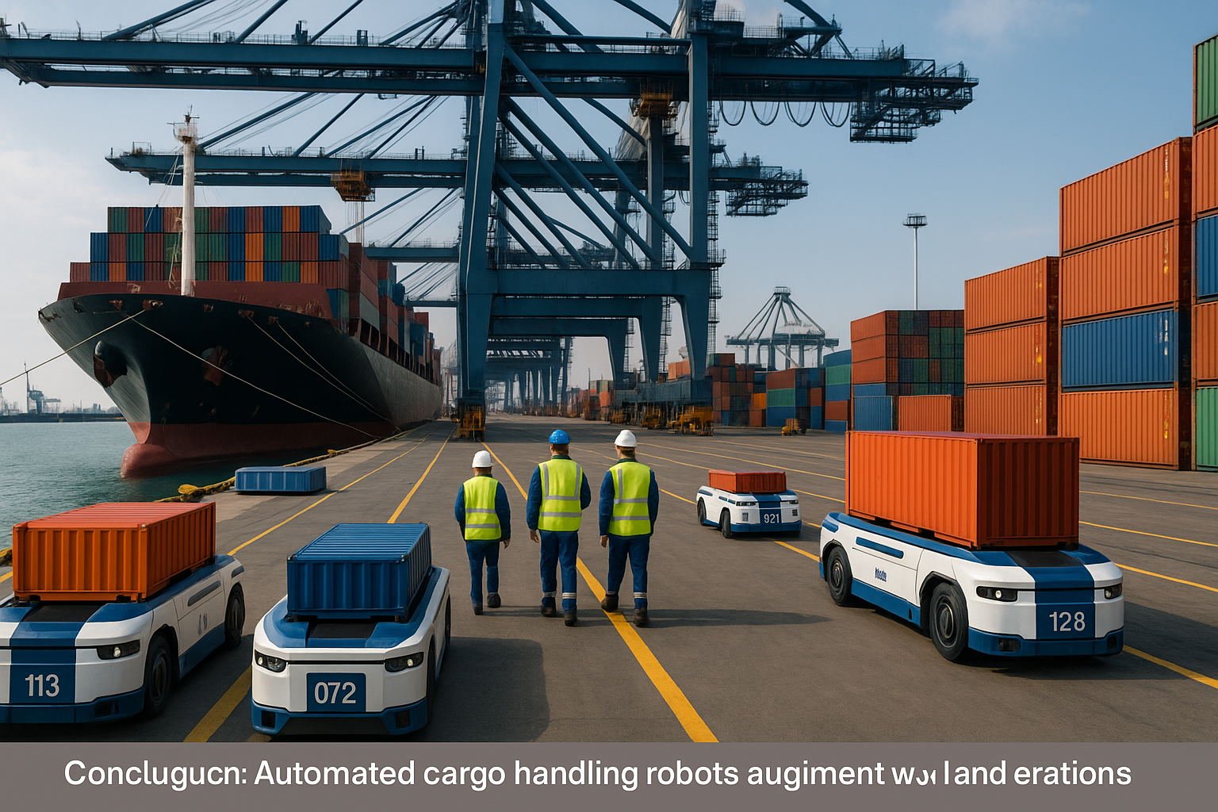
White Paper
Isidore Quantum®
All-in-One Cybersecurity and Drop in PQC Solution
Beyond the Horizon: Securing Maritime Operations from Cyber and Quantum Threats
Why Isidore Quantum:
Affordable: 70% faster to implement and 60% lower total cost of ownership
Autonomous Cyber Resilience: AI-driven system detects, adapts, and self-heals against evolving threats
Drop-In Integration: Protocol, hardware, interface-agnostic design modernizes legacy networks without infrastructure overhaul
Low-SWaP Advantage: Compact, efficient, and scalable for enterprise, defense, and critical infrastructure use
The maritime industry is confronting an urgent and worsening cybersecurity crisis that endangers global trade, national security, and operational stability. As vessels, ports, and logistics systems grow more digitally interconnected, vulnerability to ransomware, spoofing, and data manipulation has increased dramatically. Incidents such as the Eclipse AIS spoofing attack demonstrate that adversaries already possess the ability to alter navigation data, disrupt port operations, and compromise shipboard control systems in real time.
Despite the International Maritime Organization’s (IMO) requirements for integrated cyber risk management, many fleets continue to rely on outdated encryption, fragmented defenses, and manual key management, leaving vital systems exposed. Expanding dependence on hybrid IT and OT networks has further enlarged the attack surface, creating conditions where a single intrusion can spread from one vessel to an entire port ecosystem within minutes.
The emerging quantum threat is intensifying the maritime cybersecurity crisis. Nation-state actors are already conducting “Harvest Now, Decrypt Later” campaigns, capturing encrypted maritime communications and data today for future decryption once quantum computers gain cryptanalytically relevant power. When that point is reached, legacy encryption methods such as RSA, ECC, and Diffie-Hellman will fail instantly, exposing decades of navigational, operational, and financial information.
Isidore Quantum, developed by Forward Edge-AI in partnership with the NSA, offers a comprehensive solution through an integrated cybersecurity and post-quantum encryption platform designed specifically for the maritime sector. The system combines zero-trust architecture, autonomous key management, AI-powered anomaly detection, and CNSA 2.0-compliant post-quantum algorithms to protect vessels, ports, and satellite communications without expensive retrofitting. Operators gain the capability to counter current cyber threats while maintaining long-term resilience against quantum-enabled adversaries, establishing a unified and scalable path to maritime security in both the digital and post-quantum eras.
Isidore Quantum® White Paper: Maritime Forward Edge-AI, Inc. 1

Slide 2
The Threat to Maritime
The next maritime disaster will emerge from the network, not the sea. Cyber adversaries are already penetrating ships, ports, and satellite links, transforming global trade routes into digital battlegrounds. Once quantum computers achieve sufficient power, the encryption safeguarding fleets will collapse within seconds, revealing every course, cargo, and command ever transmitted. The threat has already arrived and now follows closely in the industry’s wake.
What’s vulnerable today
Bridge systems (ECDIS, AIS, GPS): Spoofed signals can mask vessel locations or simulate false traffic.
Port and logistics platforms: Ransomware halts cargo movement and disrupts customs workflows.
Propulsion and SCADA systems: Malware can manipulate engine control units remotely.
VSAT and SATCOM links: Encrypted but quantum-vulnerable, exposing command and control to interception.
Why it’s getting worse:
Legacy OT and new IT systems are converging without segmentation.
Patching and key management remain manual, inconsistent, and error-prone.
Most fleets still rely on outdated PKI frameworks already deemed obsolete by NSA’s CNSA 2.0 standard
Isidore Quantum: All-in-One Cybersecurity PQC Solution
Isidore Quantum is a compact, NSA-engineered cybersecurity and post-quantum encryption platform purpose-built to protect ships, ports, and maritime logistics networks from both current and future threats. It delivers zero-trust, CNSA 2.0-compliant security with autonomous key management and AI-driven threat detection that identifies and neutralizes spoofing, ransomware, and data manipulation in real time. Designed for seamless, drop-in integration, Isidore Quantum secures AIS, GPS, VSAT, and SCADA systems without costly retrofits or downtime. Proven across defense, naval, and commercial deployments, it provides the maritime industry with a single, scalable solution for continuous, quantum-safe protection from port to propeller.
Capability | Maritime Impact
Quantum-Resistant Cryptography (CNSA 2.0) | Uses ML-KEM and AES-256 GCM to secure AIS, GPS, VSAT, and SCADA systems against classical & quantum attacks
AI-Driven Threat Detection | Learns from threat signals to identify threats in real time
Autonomous Key Management | Eliminates PKI, certificate renewals, and human error with self-rekeying and zeroization
Red/Black Isolation & Quantum Entropy | Hardware-enforced segmentation + Quantum Random Noise Generation for provably random, one-time keys
Plug-and-Play Integration | Drop-in retrofit for existing bridge, port, and logistics networks—no refit downtime
Low-SWaP Efficiency | Operates on <8W power with sub-millisecond latency—ideal for vessels, terminals, and remote links
Compliance Made Continuous:
Isidore Quantum aligns directly with IMO, ISO 27001:2022, and NSA CNSA 2.0 requirements, turning cybersecurity from an annual audit into a living, autonomous process.
IMO Compliance: Fully supports the Govern–Identify–Protect–Detect–Respond–Recover framework.
ISO 27001 Integration: Automates key access control (A.9), secure configuration (A.12), and incident response (A.16).
CNSA 2.0 Assurance: Meets U.S. national security-grade cryptographic standards for quantum resistance.
→ Comply faster. Operate safer. Stay mission-ready
Isidore Quantum® White Paper: Maritime Forward Edge-AI, Inc. 2

Slide 3
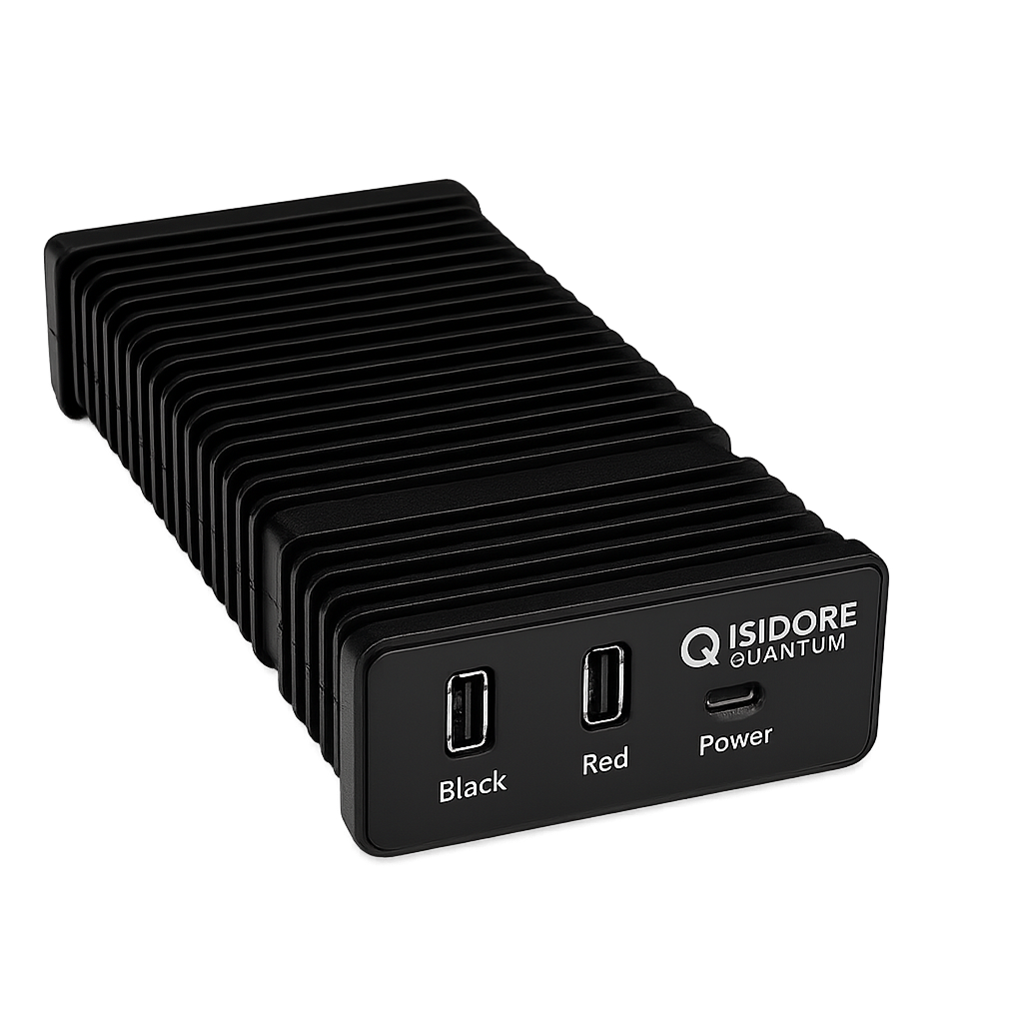
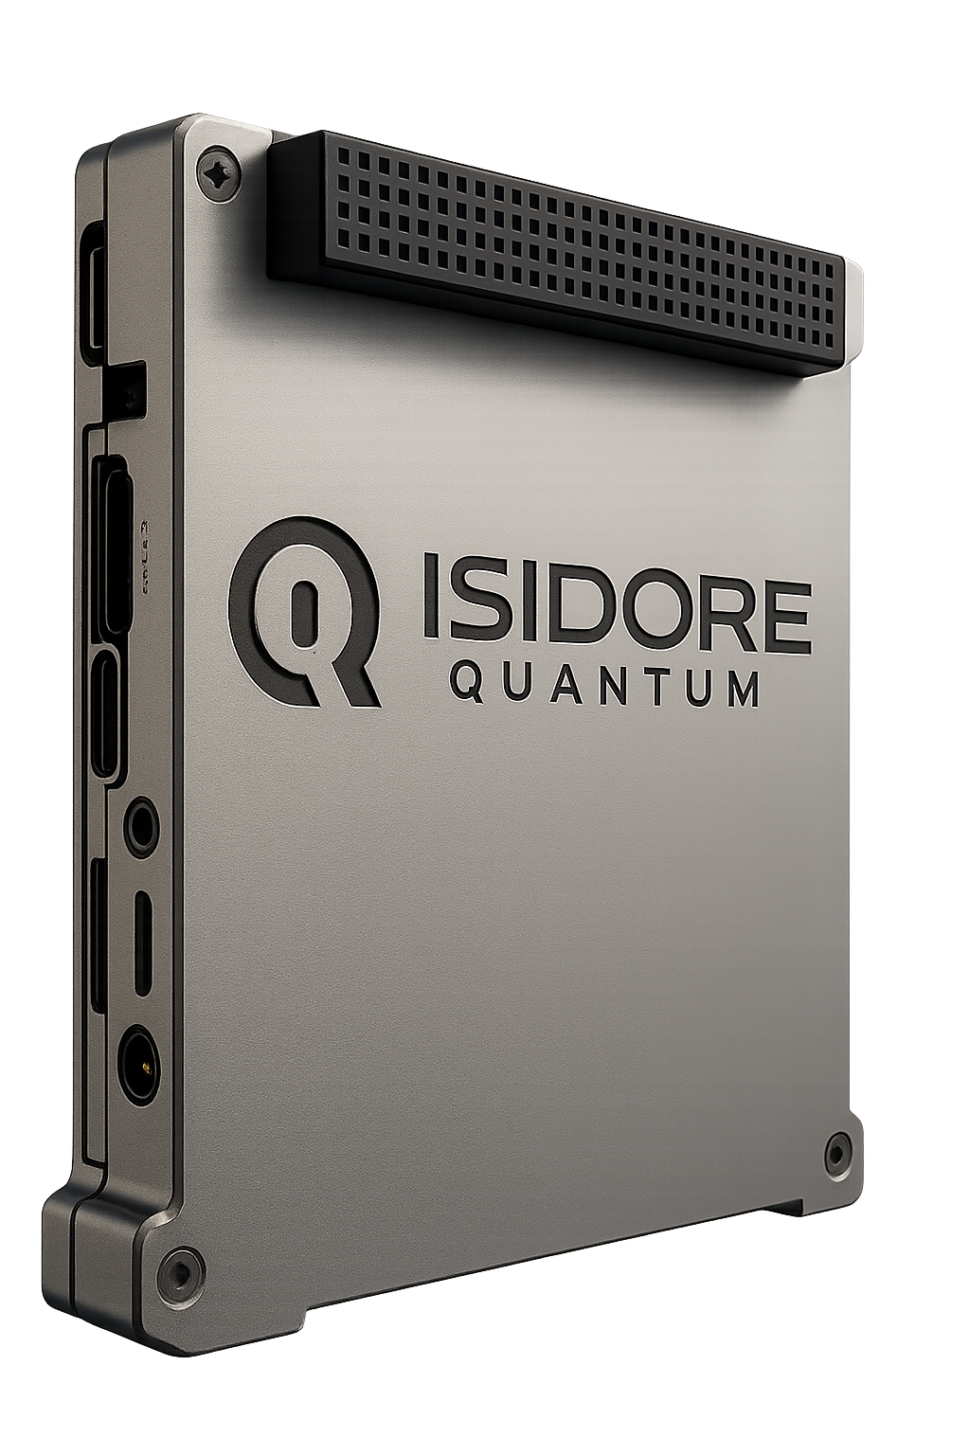
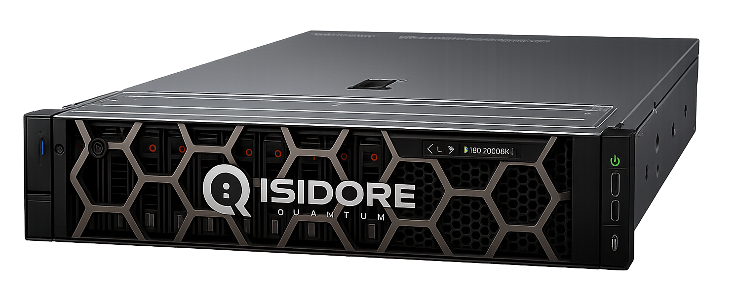
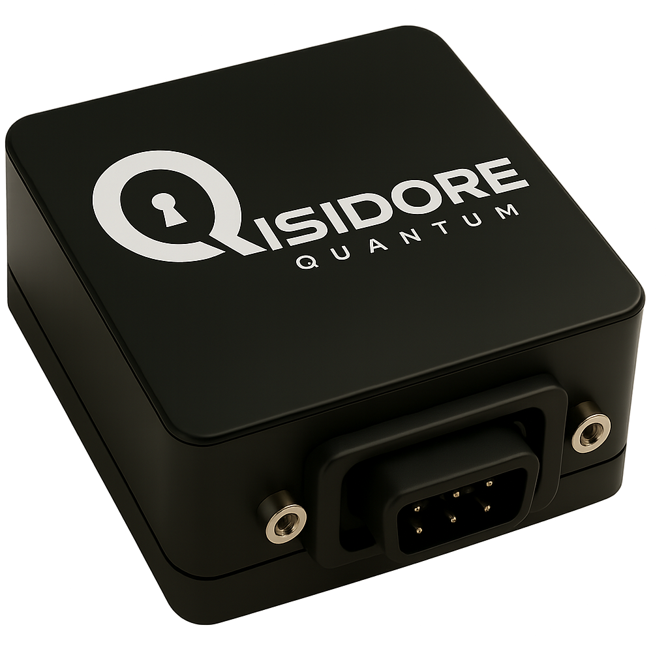
Relying on AES-256 alone creates a dangerous illusion of safety. The cipher itself remains strong, but the scaffolding around it is already crumbling. Quantum algorithms will tear through key exchanges, side-channel attacks will siphon secrets in real time, and AI-driven exploits will adapt faster than any patch. Defenders who cling to “AES-256 is enough” risk guarding an empty vault while intruders walk through unseen doors. The era ahead demands more than brute-force resistance; it demands architectures built for resilience against quantum speed, physical leakage, and machine-intelligent adversaries.
Strategic Imperatives for Maritime Leaders
Acknowledge the Dual Threat: Cybercriminals are already inside maritime networks; quantum adversaries are next.
Conduct a Cryptographic Inventory: Identify all systems relying on RSA, ECC, or PKI-based encryption.
Adopt a Zero-Trust Posture: Assume breach, segment IT/OT systems, and authenticate every session.
Deploy Isidore Quantum®: Start with bridge systems, port command centers, and satellite gateways.
Lead, Don’t Follow: Early adoption demonstrates compliance leadership, reduces insurance risk, and protects global trade lanes.
The Takeaway
Isidore Quantum® is the first and only drop-in, AI-powered, quantum-safe platform that unifies cybersecurity and post-quantum defense across the entire maritime ecosystem—from port to propeller to orbit.
Secure your fleet. Protect your trade. Build for the quantum era—now.
Variants and Specifications:
Isidore-1: IoT/OT/SCADA
Isidore 50MB/s –
2 GB/s
One-Way-Data Diode
CubeSat
Enterprise
 | 50 Mb/s | 480 Mb/s | 1 - 2 Gb/s | 10 Gb/s | 68 Gb/s | 1 Tb/s
Size, Weight & Power | ~140 x 89 x 39 mm (5.5 x 3.5 x 1.5 in); 450 g (16 oz); ~7 W | ~140 x 89 x 39 mm (5.5 x 3.5 x 1.5 in); 450 g (16 oz); ~10 W | ~140 x 89 x 39 mm (5.5 x 3.5 x 1.5 in); 450 g (16 oz); ~12 W | Available Q3 2026 | Available Q3 2026 | Available Q4 2026
Environmental: | –40 °C to +85 °C; shock and vibration qualified
Cryptography: | AES-256 GCM and ML-KEM
Quantum Entropy: | Integrated Quantum Random Number Generator (QRNG) subsystem; validated per NIST SP 800-90 A/B/C and BSI AIS-31
Topologies: | Point-to-point, point-to-multipoint, mesh, and hub-and-spoke; supports wired, wireless, and hybrid topologies
Certifications and Compliance: | NSA CNSA 2.0, FIPS 140-3 (Level 3), NIST SP 800-90 A/B/C, BSI AIS-31, ECCN 5A002 (License Exception ENC)
Latency: | <90 µs (estimated)
Security Architecture | Hardware-enforced Red/Black separation with galvanic isolation; zero-trust, zero-touch operation; covert posture (no network announcements or responses to probes)
AI / Autonomy | Embedded AI engine trained for real-time anomaly detection, and self-healing response
Management System: | Cassian™ for fleet orchestration, provisioning, telemetry, and policy governance across distributed deployments
Specifications listed are subject to change without prior notice.
Contact: Brandon@Forwardedge.ai | forwardedge.ai
Isidore Quantum® White Paper: Maritime Forward Edge-AI, Inc. 2

